Slide 1
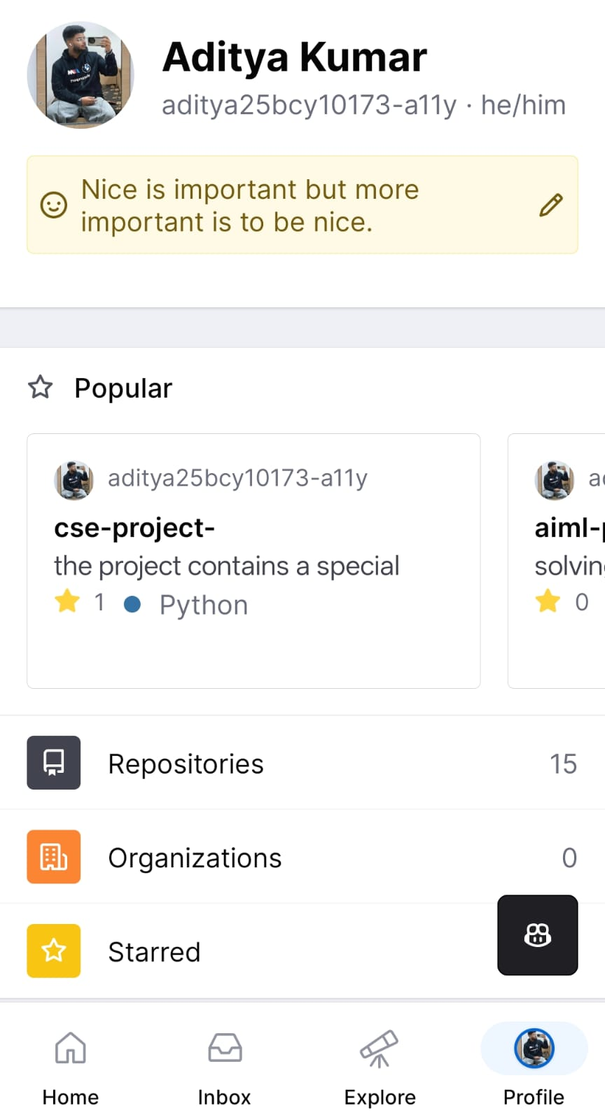
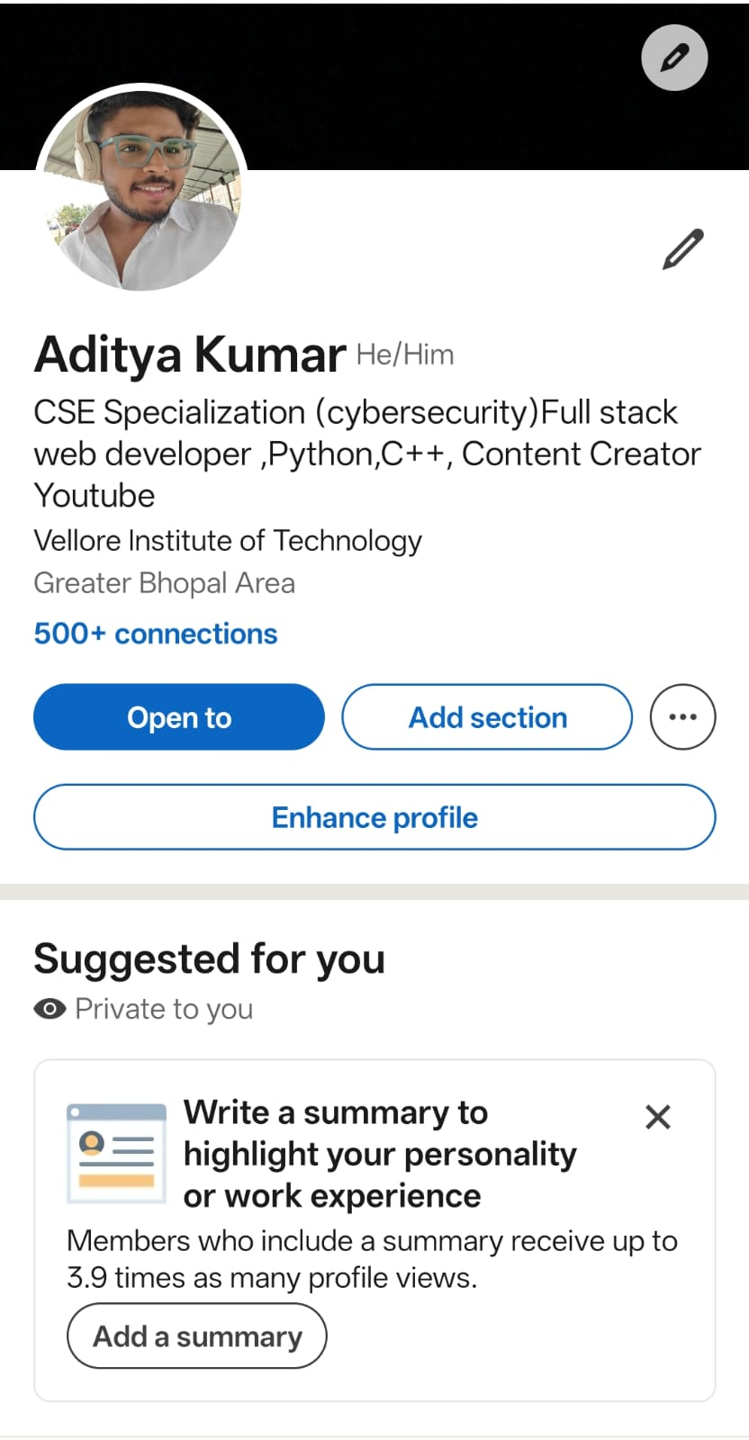

Slide 2
Project Report
I have chosen LinkedIn and GitHub as my primary platforms for professional growth. LinkedIn is mainly used for building a professional network, showcasing achievements, and staying updated with industry trends. It allows me to connect with professionals, join communities, and explore internship and job opportunities. GitHub, on the other hand, is a platform for hosting and sharing code, collaborating on projects, and demonstrating technical skills through repositories and contributions.
Over the next four years, I plan to actively use LinkedIn to build a strong professional presence by regularly updating my profile, sharing my projects, and engaging with posts related to my field. I will also connect with industry experts and recruiters to learn and grow. On GitHub, I aim to consistently upload my projects, contribute to open-source communities, and improve my coding skills. By maintaining an active presence on both platforms, I will create a solid portfolio and network that will support my career development and future job opportunities.

